Slide 1
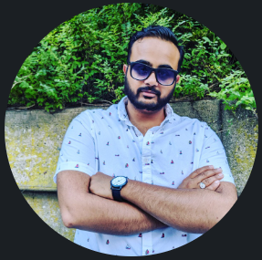

The Same Approach to Breaking into Information Security but {d!f3r3nt}
By Veran Patel
Associate InfoSec Analyst
Green Thumb Industries

Slide 2
whoami
Eve Spreadsheets
Security enthusiast
Started lifting / Working out
Challenger
Student at WGU
Associate InfoSec Analyst
ITIL v4
A+
More to come….
Notes:
I am a student at WGU, I started 2 years go and currently have completed about 44% of my course work.
Had Associate InfoSec job for about 8 months and 27 days
I have two certs, ITIL v4 and A+
Currently working on Project +
I play Eve online a lot.. Like A LOT
I like security in general and wanted to get into it for some time now.
Started working out and been feeling great.. Afterward. Definitely not during.
Challenger, I challenger people, myself, my boss, people around me.

Slide 3
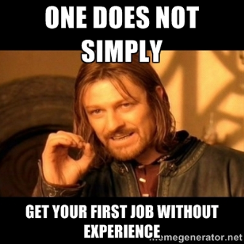
InfoSec Requirements
U.S. Bureau of Labor Statistics
Information Security Analyst should have at least a Bachelor’s Degree
Less than 5 years of work experience in the field
Security + as an entry cert and CISSP for experienced people
Notes:
According to U.S. Bureau of Labor Statistics, and An information Security Analyst should have at least a Bachelor’s Degree. Only a few places allow people to enter the with a high school diploma and relevant industry training and certifications.
Less than 5 years of work experience in the field.
Security + as an entry cert and CISSP for experienced people.
Job postings for no a days require crazy amount of experience and even cert like CISSP.

Slide 4
BAD Story and GOOD Lessons
Started working at CDW to get back into IT.
Every other place asked for DEGREE!! UGH
I kept getting Service Desk / Help Desk Jobs
WHAT DO I DO?
Learned what kind of company I want to work for.
Understood what a security analyst does
Talked to a few Security Analysts are BP (place I was working).
Notes:
Talk about CDW and how my experience there made me feel better in thinking I can get into IT
Everyplace after that, they kept asking for a Degree at the least or 3-4 certs
I was too good for Service desk but not good enough for anything else. How? Why?
Wanna work at a company that gives back to the world, community.
Viewing logs, reviewing policies, investigating, etc.
Build connections or just had a one-off meeting with a few Security Analysts

Slide 5
BAD Story and GOOD Lessons
3 years later….
No changes and nothing happened.
Time to make change
What kind of change?
Talking to the RIGHT people!
Understand that you will never match 100% of the job description and that is OKAY!
If you match 60% - 75% then you are good.
Use power words/buzz words in your resume that show up in the JD
Notes:
3 yrs later, Still not in InfoSec so… I knew I needed to change.
I was not talking to the right people because I was talking to everyone that showed interests and not those who I knew could help or had mentor XP.
JD is just meh, cause most of the time, its just recruiters who make those and sometimes they do not know what is needed.
Example: CISSP for an Entry Level position that mays under $100K.
When you apply, resume goes into HR system then software checks for credentials, power words.
How to get past it?
Look at JD, find power words and add them where you can into your resume.
After that If you match then you are passed along to the recruiter, hiring manager and so on.

Slide 6
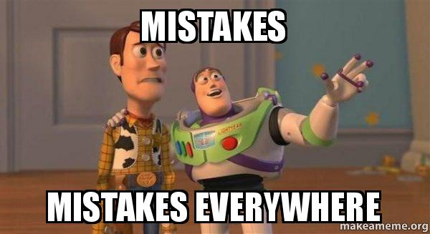
Mistakes I MADE or DID?
Trusting everyone
Getting my hopes high and getting crushed
Not selling myself
Not showing my strengths and weaknesses
Not acknowledging what I need to work on
Notes:
Trusting everyone - not everyone is your friend but will be friendly.
Getting my hopes high and getting crushed - just because they didn’t call you does not mean you don’t know anything. Keep on trying and play the law of averages. The more you do something, the better you will get at it
Not selling myself - Don’t sell yourself short, you got here because you worked hard to this point. Wheater it is school, certs, research, CTFs, Blueteamlabs, etc. Show those small wins that accumulated too today.
Not showing my strengths and weaknesses - No one is good at everything, but you can increase your baseline up a bit. If you don’t know something, then work on it so you can be more than familiar with the subject.
Not acknowledging what I need to work on - if you don't know how to do something or if you make a mistake. IT IS OKAY to say I do not know. He second part is important, “But I can work on that, or I can find out”

Slide 7
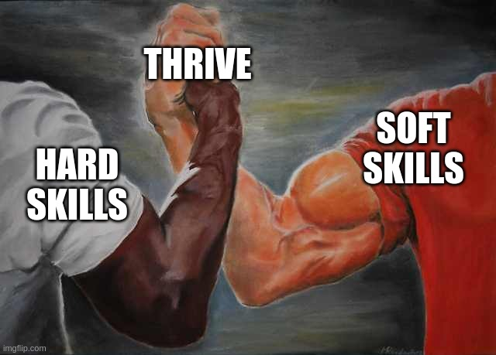
Soft sKills I mean SKILLS…
Analytical skills
Communication
Creative
Detail oriented
Problem-solving
Critical thinking
Research
Notes:
Communication - Written communication, Reporting, Surveying, Teamwork
Creative - Budgeting
Yeah, I know. Weird but true. Gotta be creative to save money and even make money. Something make money last!
Brainstorming
Collaboration
Optimization
Predictive modeling
Restructuring
Strategic planning
Detail oriented
Problem-solving
Critical thinking
Process management, what should start finish now so i can start on the later.
Diagnostics
Evaluating
Troubleshooting
Judgment
Causalities, this happened cause 1 happened which caused 3 and 4 to break and 2 to be compromised.
Research
Investigations!!
Metrics
Data collection
Accuracy rating

Slide 8
Study Materials
Professormesser.com (A+, Sec+, Net+)
Quizlet.com (for classes and cert prep)
Linuxupskillchallenge.com (Linux skill learner - very chill and informational. Start to end walkthroughs and help available.)
The Cyber Mentor (Heath Adams, TCM Security that has monthly subscriptions)
Blackwatchmen (OSINT game on steam)
Cybrary.com (Online skill learning like Pluralsight but has very good mats and classes)
Overthewire.org (old school and fun hacking CTF thingy)
Blueteamlabs.com (Blue Team and Red Team)
Tryhackme.com (Blue Team and Red Team)
Hackthebox.eu (Red team w/ other skills)

Slide 9
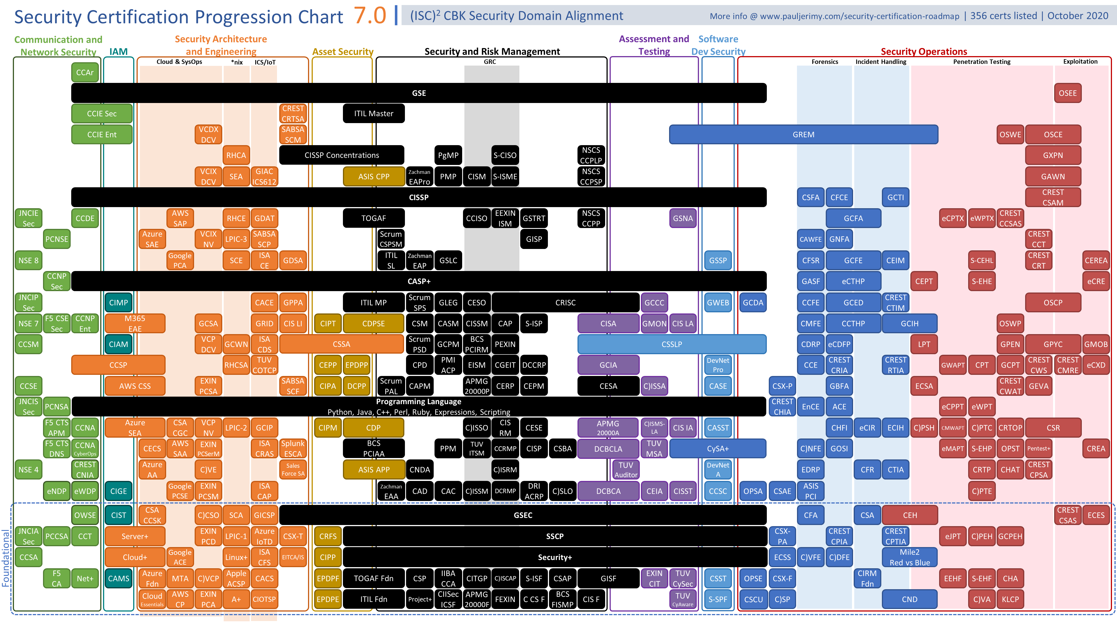
Starting Certifications
ITIL v4
A+
Network +
Security +
https://pauljerimy.com/security-certification-roadmap/

Slide 10
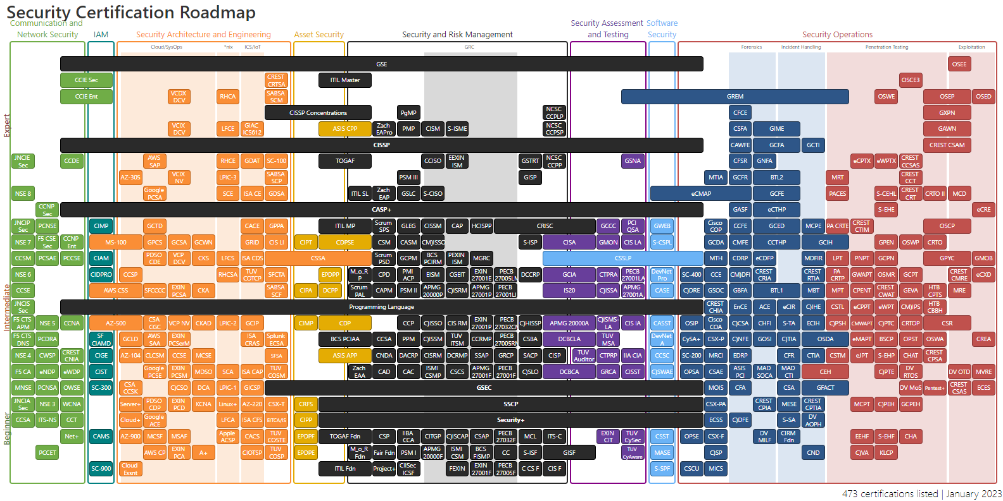
https://pauljerimy.com/security-certification-roadmap/

Slide 11
How do YOU start?
Introduce yourself and state your intent!
Be NICE and respectful!
Learn and don’t get stuck up on the sense of self!
You started! By coming to BlueTeamCon
You are doing great by coming here and I hope you learn a lot.
Attending conferences or joining a discord channel would be a great step. This way you get to talk to people!
See what’s out there, see how other people in the job do! Ask Questions if you do not know about anything.
Notes:
You started! By coming to BlueTeamCon
You are doing great by coming here and I hope you learn a lot.
Attending conferences or joining a discord channel would be a great start. This way you get to talk to people!
See what's out there, see how other people in the job do! Ask Questions if you do not know.
Introduce yourself and state your intent!
Hi! My name is Veran and I heard you talking about _____, I am interested in starting a career in ___. (Or I am looking into switching to _____.) Do you have any pointers? How did you start?
Be NICE and respectful!
Learn and don't get stuck up on the sense of self!

Slide 12

Questions Comments Thoughts?
LinkedIn: verankpatel

